Slide 1
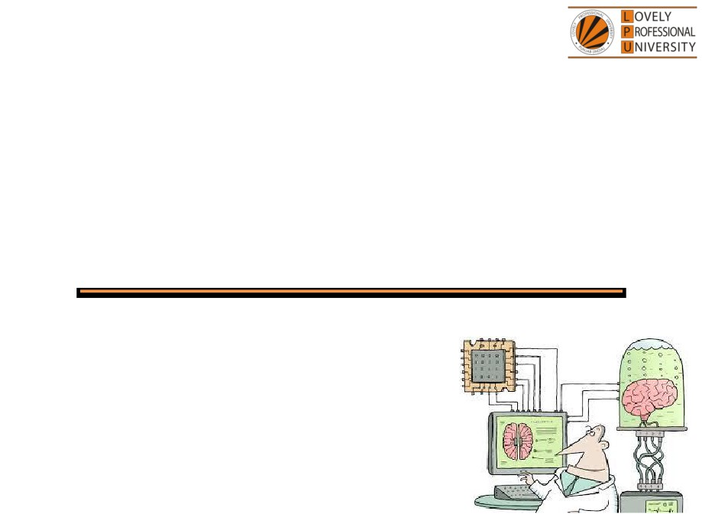
PEA305
Analytical Skills I
Lecture #0
Breaking the ice
Department of Analytical Skills

Slide 2

Course Details
LTP - 2 1 0 [Two lectures, One Tutorial per week]
Text Book
Quantitative Aptitude by Dr.R S Aggarwal
Reference Book
Quantitative Aptitude by M Tyra
Quantitative Aptitude by Abhijit Guha

Slide 3
Course Assessment Model
Marks break up
• Attendance
15
• CA
30
• MTE (MCQ)
15
• ETE (MCQ)
40
• Total
100
• MTE & ETE to be done on OMR sheets
All tests will be based on MCQ.

Slide 4

Course Outcomes
CO1 :: demonstrate procedural fluency with number system and mathematical operations to solve the stated problems.
CO2 :: select an appropriate approach to solve problems related to percentage, profit and loss.
CO3 :: observe the data given and interpret given number and alphanumeric series
CO4 :: apply the analytical concepts learnt to solve the questions of ratio and proportion
CO5 :: use the concepts of permutation, combination and probability to handle various problems.
CO6 :: analyze the reasoning aptitude problems such as blood relation and direction sense to solve related problems.

Slide 5
Course focus identification
Employability

Slide 6
Assessment and Evaluation Model
Assessment (Category) | Conducted Week
CA 1 (A0303) | Week 5 (Duration 50 Min Q 30)
MTE (11A) | After week 7 (Duration 60 Minutes Q 40)
CA 2 (A0303) | Week 10 (Duration 50 Min Q 30)
CA 3 (A0303) | Week 14 (Duration 50 Min Q 30)
ETE (11A) | After week 14 (Duration 120 Min Q 80)

Slide 7
Pedagogical initiative
Week | Workshops
5th | Number Ninja
12th | Perocity
13th | Puzzle Mania
Week | Competitive event
6th | Semantic analogy
7th | Mind opener
14th | Knack
Foundation classes- Week 7th and 14th

Slide 8
Innovative evaluation strategies
Evaluation | Conduct
CA 1 | External
MTE | External
CA 2 | External
CA 3 | External
ETE | External

Slide 9
Unit wise course content
Unit I
Number system : HCF & LCM, divisibility rules, classification of numbers, factors, factorials, unit digit calculation, remainder properties
Simplification and approximation : BODMAS rule, calculation and approximation based on percentage, problem based on digit sum
Average : basic average calculations, average increase and decrease, weighted average
Unit II
Percentage : basic percentage calculations, percentage to fraction, percentage comparison, percentage increase and decrease, population change in percentage
Profit loss discount : basic concepts of cost price selling price and marked price, calculations of profit and loss percentage, types of discount and discount percentages, comparison of profit or loss with discount percentage Simple and compound interest : basic concepts of interest calculations, comparison of simple and compound interest
Unit III
Logical reasoning : number series with introduction of AP and GP, alphabet series, alphabet test, coding and decoding, language coding

Slide 10
Unit IV
Ratio and proportions : basic concepts of ratio and proportions and ages, problems based on ratio and proportions and ages, problems based on partnerships and profit sharing
Alligation and mixtures : conceptual knowledge of alligation and mixtures, problems based on alligation and mixtures
Unit V
Permutation : basic principle of counting, numerical permutation(formation of numbers and sum of numbers), alpha permutation(rearrangement of words and rank of a word), linear and circular permutation, logical permutation
Combination : basic formulas of combination, formation of committee, combination of identical objects Probability : concept of probability, classification of events, conditional probability, problems based on coins dices and cards
Unit VI
Analytical reasoning : blood relations, direction sense test

Slide 11


Let us look around…
Why every organization takes Quantitative Aptitude Tests before hiring any future employee…

Slide 12
Right Decision Making
Mental Alertness
Ability to quickly interpret data
Establish logical relationship
Arrive at the correct conclusions
Make the right judgment

Slide 13
Organizations recruit people who have
Quick Mental Abilities.
PEA502 Analytical Skills-II :: Vishal Ahuja

Slide 14
How you will make your mental ability Quick…!!!
Quick = Tricks
PEA502 Analytical Skills-II :: Vishal Ahuja

Slide 15
123456^654321
Find the unit digit

Slide 16
And What about this….?
In how many ways the committee of 5 members be formed out of 7?

Slide 17

5 minute…???
10 minutes…???
15 minutes…???
20 minutes…???
Again…!!! It will not take more than 30 SECONDS.

Slide 18

A person invested a sum of Rs.750 in a bank at simple interest. After 5 years he received Rs.1200. Find the rate of interest offered by the bank.
What do we need to know?

Slide 19
What do we need to know?
This course PEA305 : Analytical Skills-I
Ability to efficiently solve the company specific Quantitative
Aptitude Tests.
Ability to prioritize and manage Time.
Ability to efficiently analyze data.

Slide 20


Next Class: Number System

